Slide 1
PROJECT REPORT TEMPLATE
Visualization tool for electric vehicle charge and Range analysis
Dr . Nallikuppusamy Arts college , Thanjavur
Faculty Mentor Mrs. C.UMA DEVI M.sc.,M.phil
Projected done by
A.Abinaya -Team Leader
P.Ajitha -Team Member
K.Janani Desika- Team Member
M.Lathika- Team Member
R.Rajalakshmi- Team Member

Slide 2
INTRODUCTON
A vehicle that can be powered by an electric motor that draws electrically from a battery and is capable of being charged from an external source and have an electric motor instead of an internal combustion engine.
The modern mechatronic vehicle manages electrical storage and propulsion system with electric sensors, controls, and actuators, integrated closely with software, secure data transfer, and data analysis ,to from a comprehensive transportation solution .

Slide 3
Purpose
Electric vehicle use electricity to charge their batteries instead of using fossil fuels like petrol or diesel. Electric vehicles are more efficient, and that combined with the electricity cost means that charging an electric vehicle is cheaper than filling petrol or diesel for your travel requirements.

Slide 4
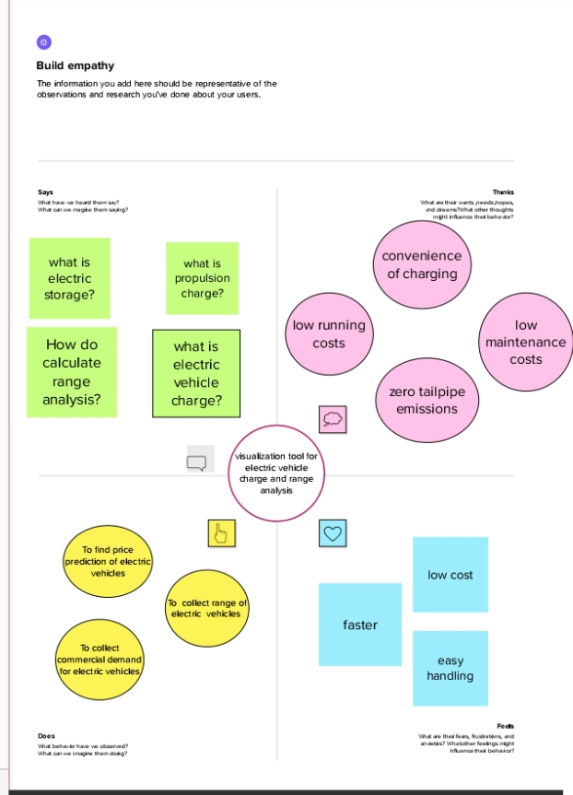
EMPATHY MAP

Slide 5


Slide 6
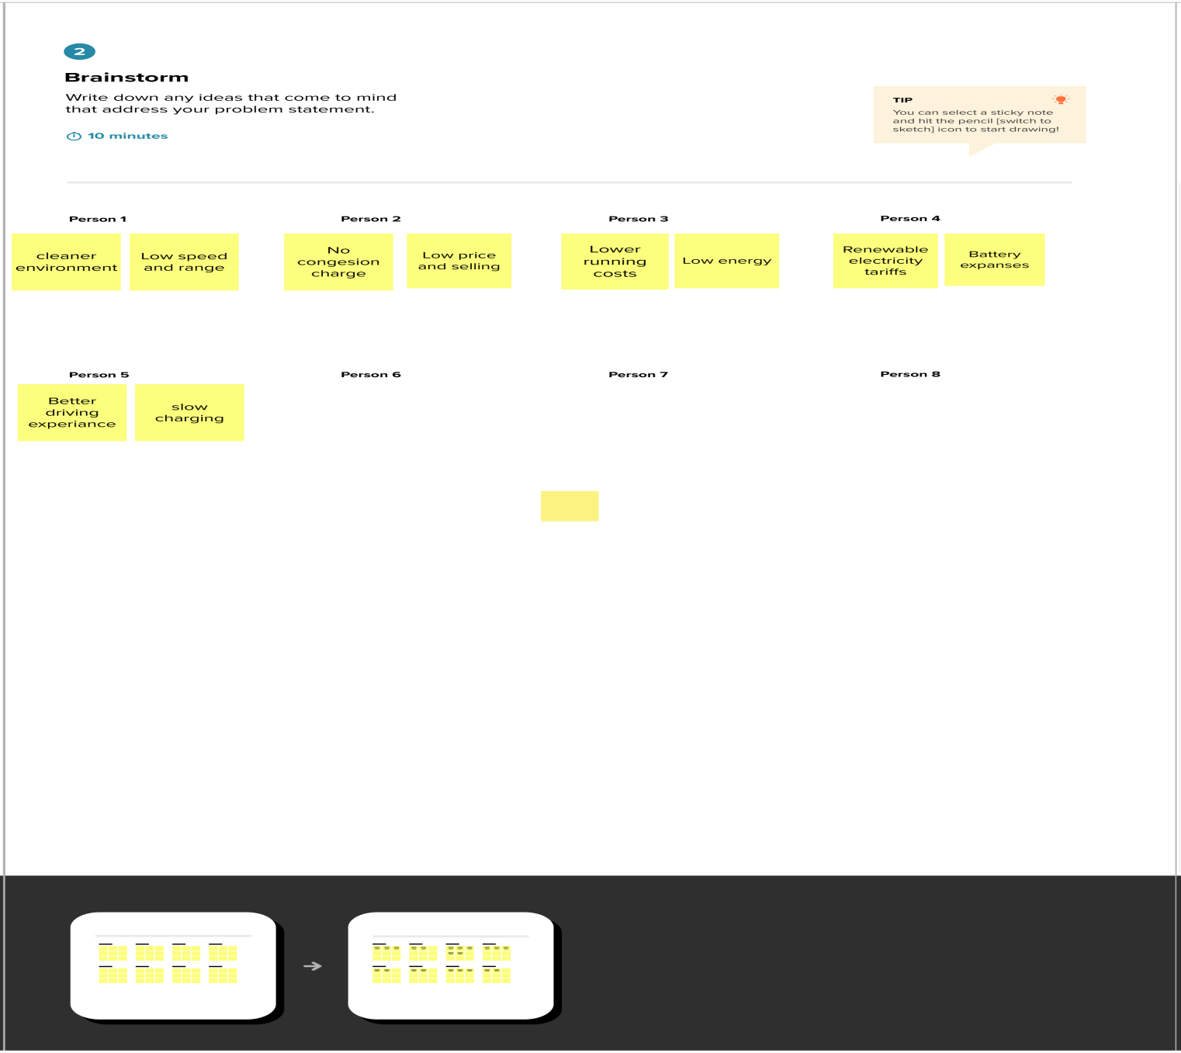

Slide 7
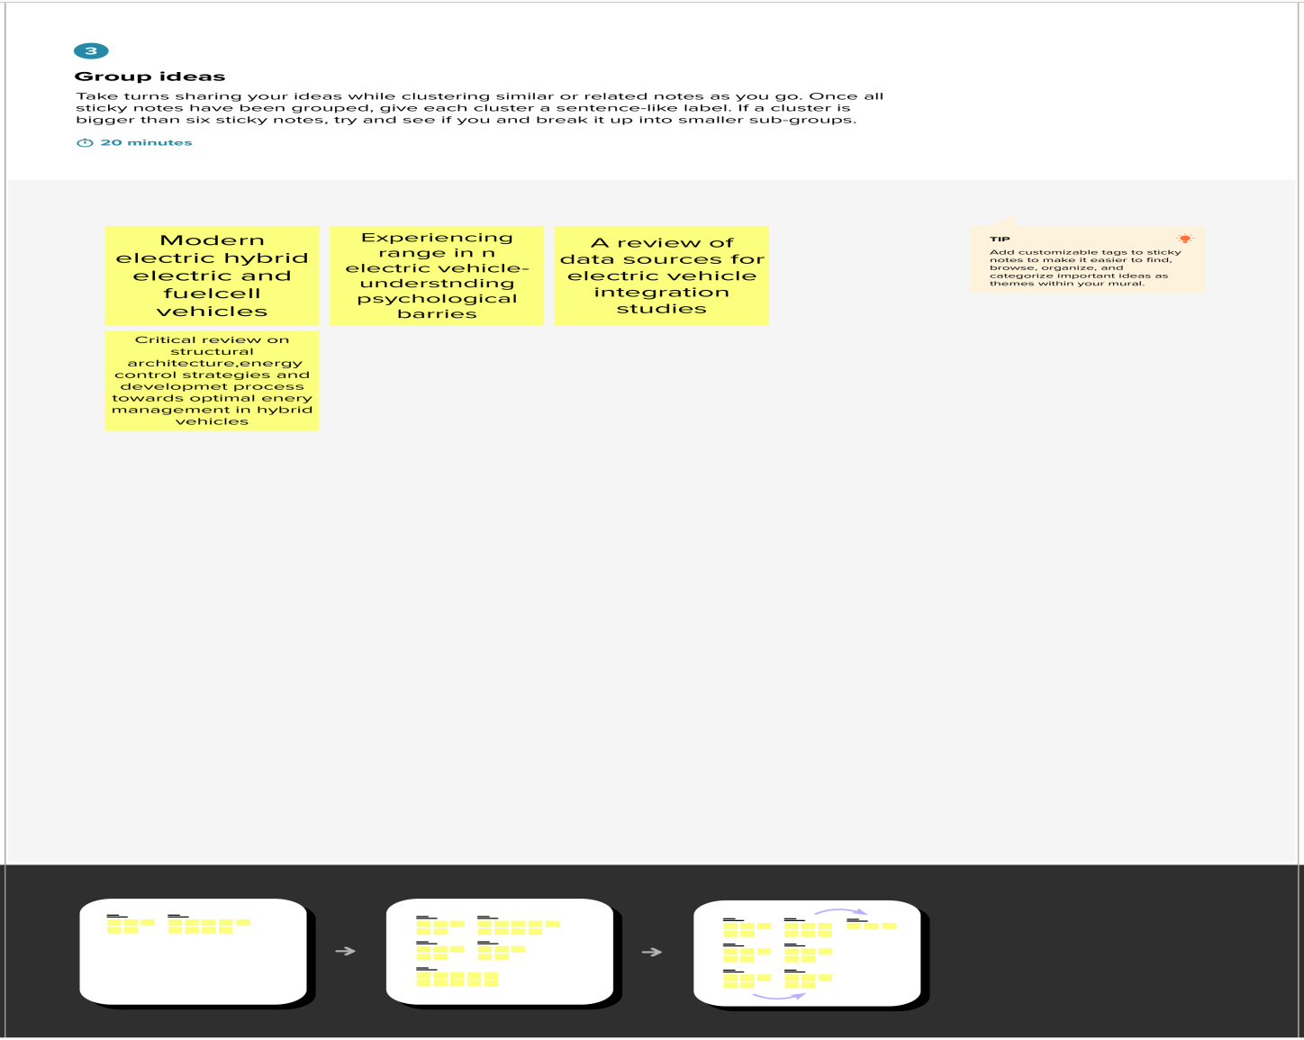

Slide 8
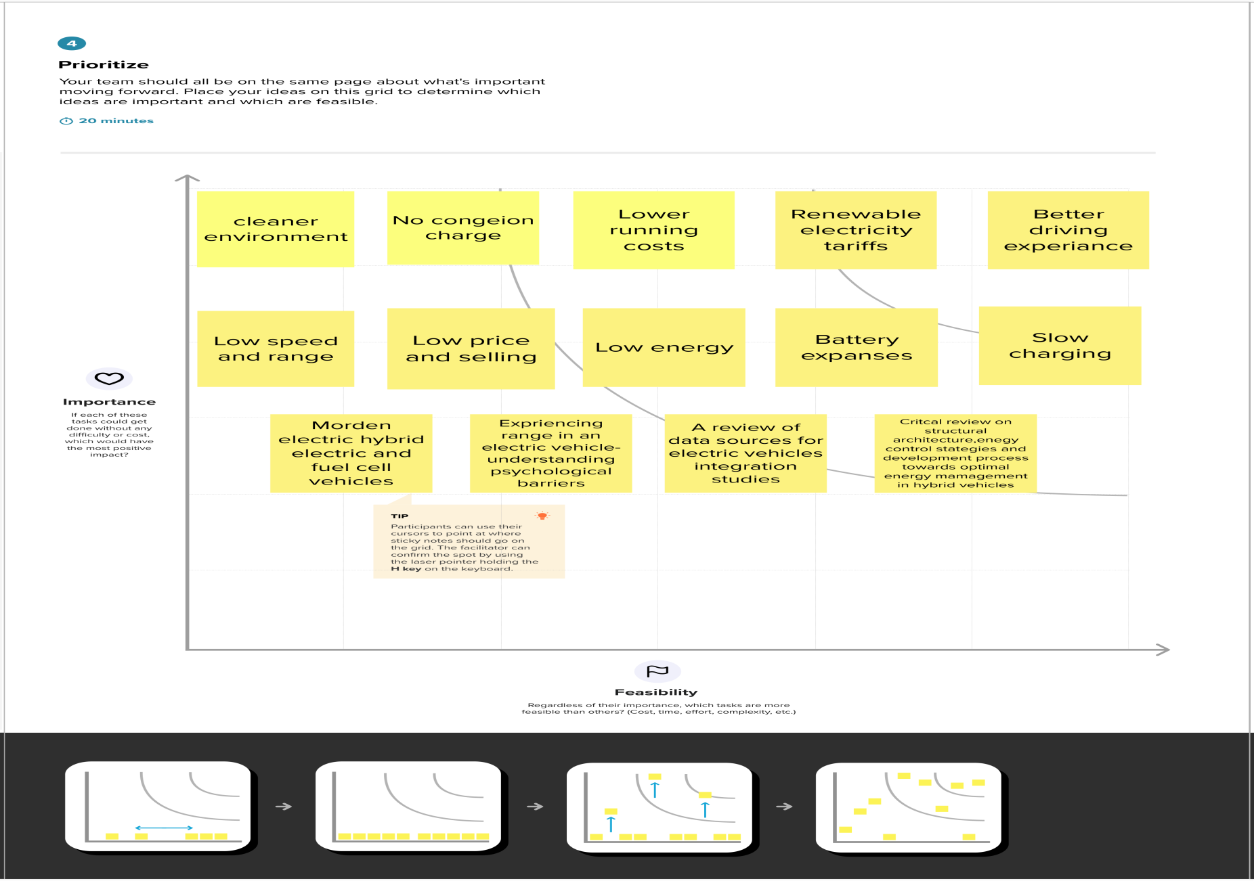

Slide 9
DASHBOARD

Slide 10
Story 1
RANGE AND PRICE RANGE
TOP MODEL AND CNT
Vehicle Ty.. _{Range}
306 Km/Full Charge
312 Km/Full Charge
388 Km/Full Charge
400 Km/Full Charge
415 Km/Full Charge
419 Km/Full Charge
425 Km/Full Charge
437 Km/Full Charge
452 Km/Full Charge
470 Km/Full Charge
471 Km/Full Charge na
300
Electric
PriceRange(Lakhs)
200
100
0
Compact SUV
Premium Coupe Premium Fullsi..

Slide 11
Story 1
RANGE
TOP MODEL AND CNT
STYLE AND SUM (PRICE RANGE)
AND
PRICE R..
Top Model
Style
Compact SUV Premium Coupe Premium Fullsize SUV Premium Midsize Sed.. Premium Sports Sedan Subcompact MPV Subcompact Sedan
Count of EVIndia.csv
6
4
2
0
Dark XZ Plus LUX
Exclusive
HSE
na

Slide 12
Advantages of electric vehicles
Eco –friendly
Renewable energy sources
Less noise and smoother motion
Cost effective

Slide 13
Disadvantages of electric vechicles
Expensive
Temperature issues
Less performance
Less driving range
Limited options

Slide 14
CONCLUSION
Electric vehicles will benefit the economy through fuel efficiency, the environment through reduced carbon emissions, society through more togetherness and the legal system through a simpler system of liability.

Slide 15
Future scope
The availability of fossil fuels is limited, and their use is destroying our planet. Toxic emissions from petrol and diesel vehicles lead to long-term, adverse effects on public health. The emissions impact of electric vehicles is much lower than petrol or diesel vehicles.
Consumers in India are looking for a lower price for Evs than those in other countries .

